Slide 1
Beginning genealogy
Finding Your Rotarian Roots
© 2022 Fellowship of Rotarian Genealogists. All Rights Reserved.
Presented by Bill Harvey, President
Fellowship of Rotarian Genealogists
Rotary Convention, Houston, 7 Jun 2022

Slide 2

The Fellowship of Rotarian Genealogists
Beginning Genealogy 7 June 2022
Open to Rotarians and others, world-wide, who share a love of genealogy and family history
Annual Membership: $20
Lifetime Membership: $100
Quarterly Newsletter, Quarterly Video Meetings
Booth at most Rotary International Conventions
Website: RotarianGenealogists.org
Facebook: facebook.com/RIfellowship
This Fellowship operates in accordance with Rotary International policy, but is not an agency of, or controlled by, Rotary International
© 2022 Fellowship of Rotarian Genealogists. All Rights Reserved.

Slide 3
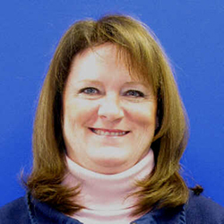
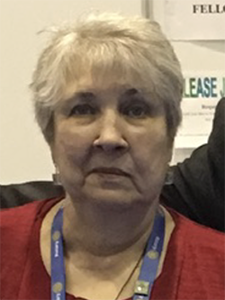
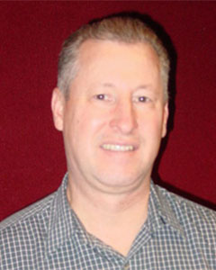
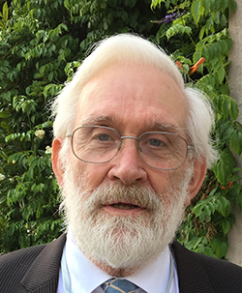
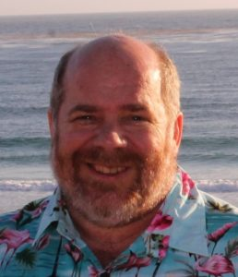
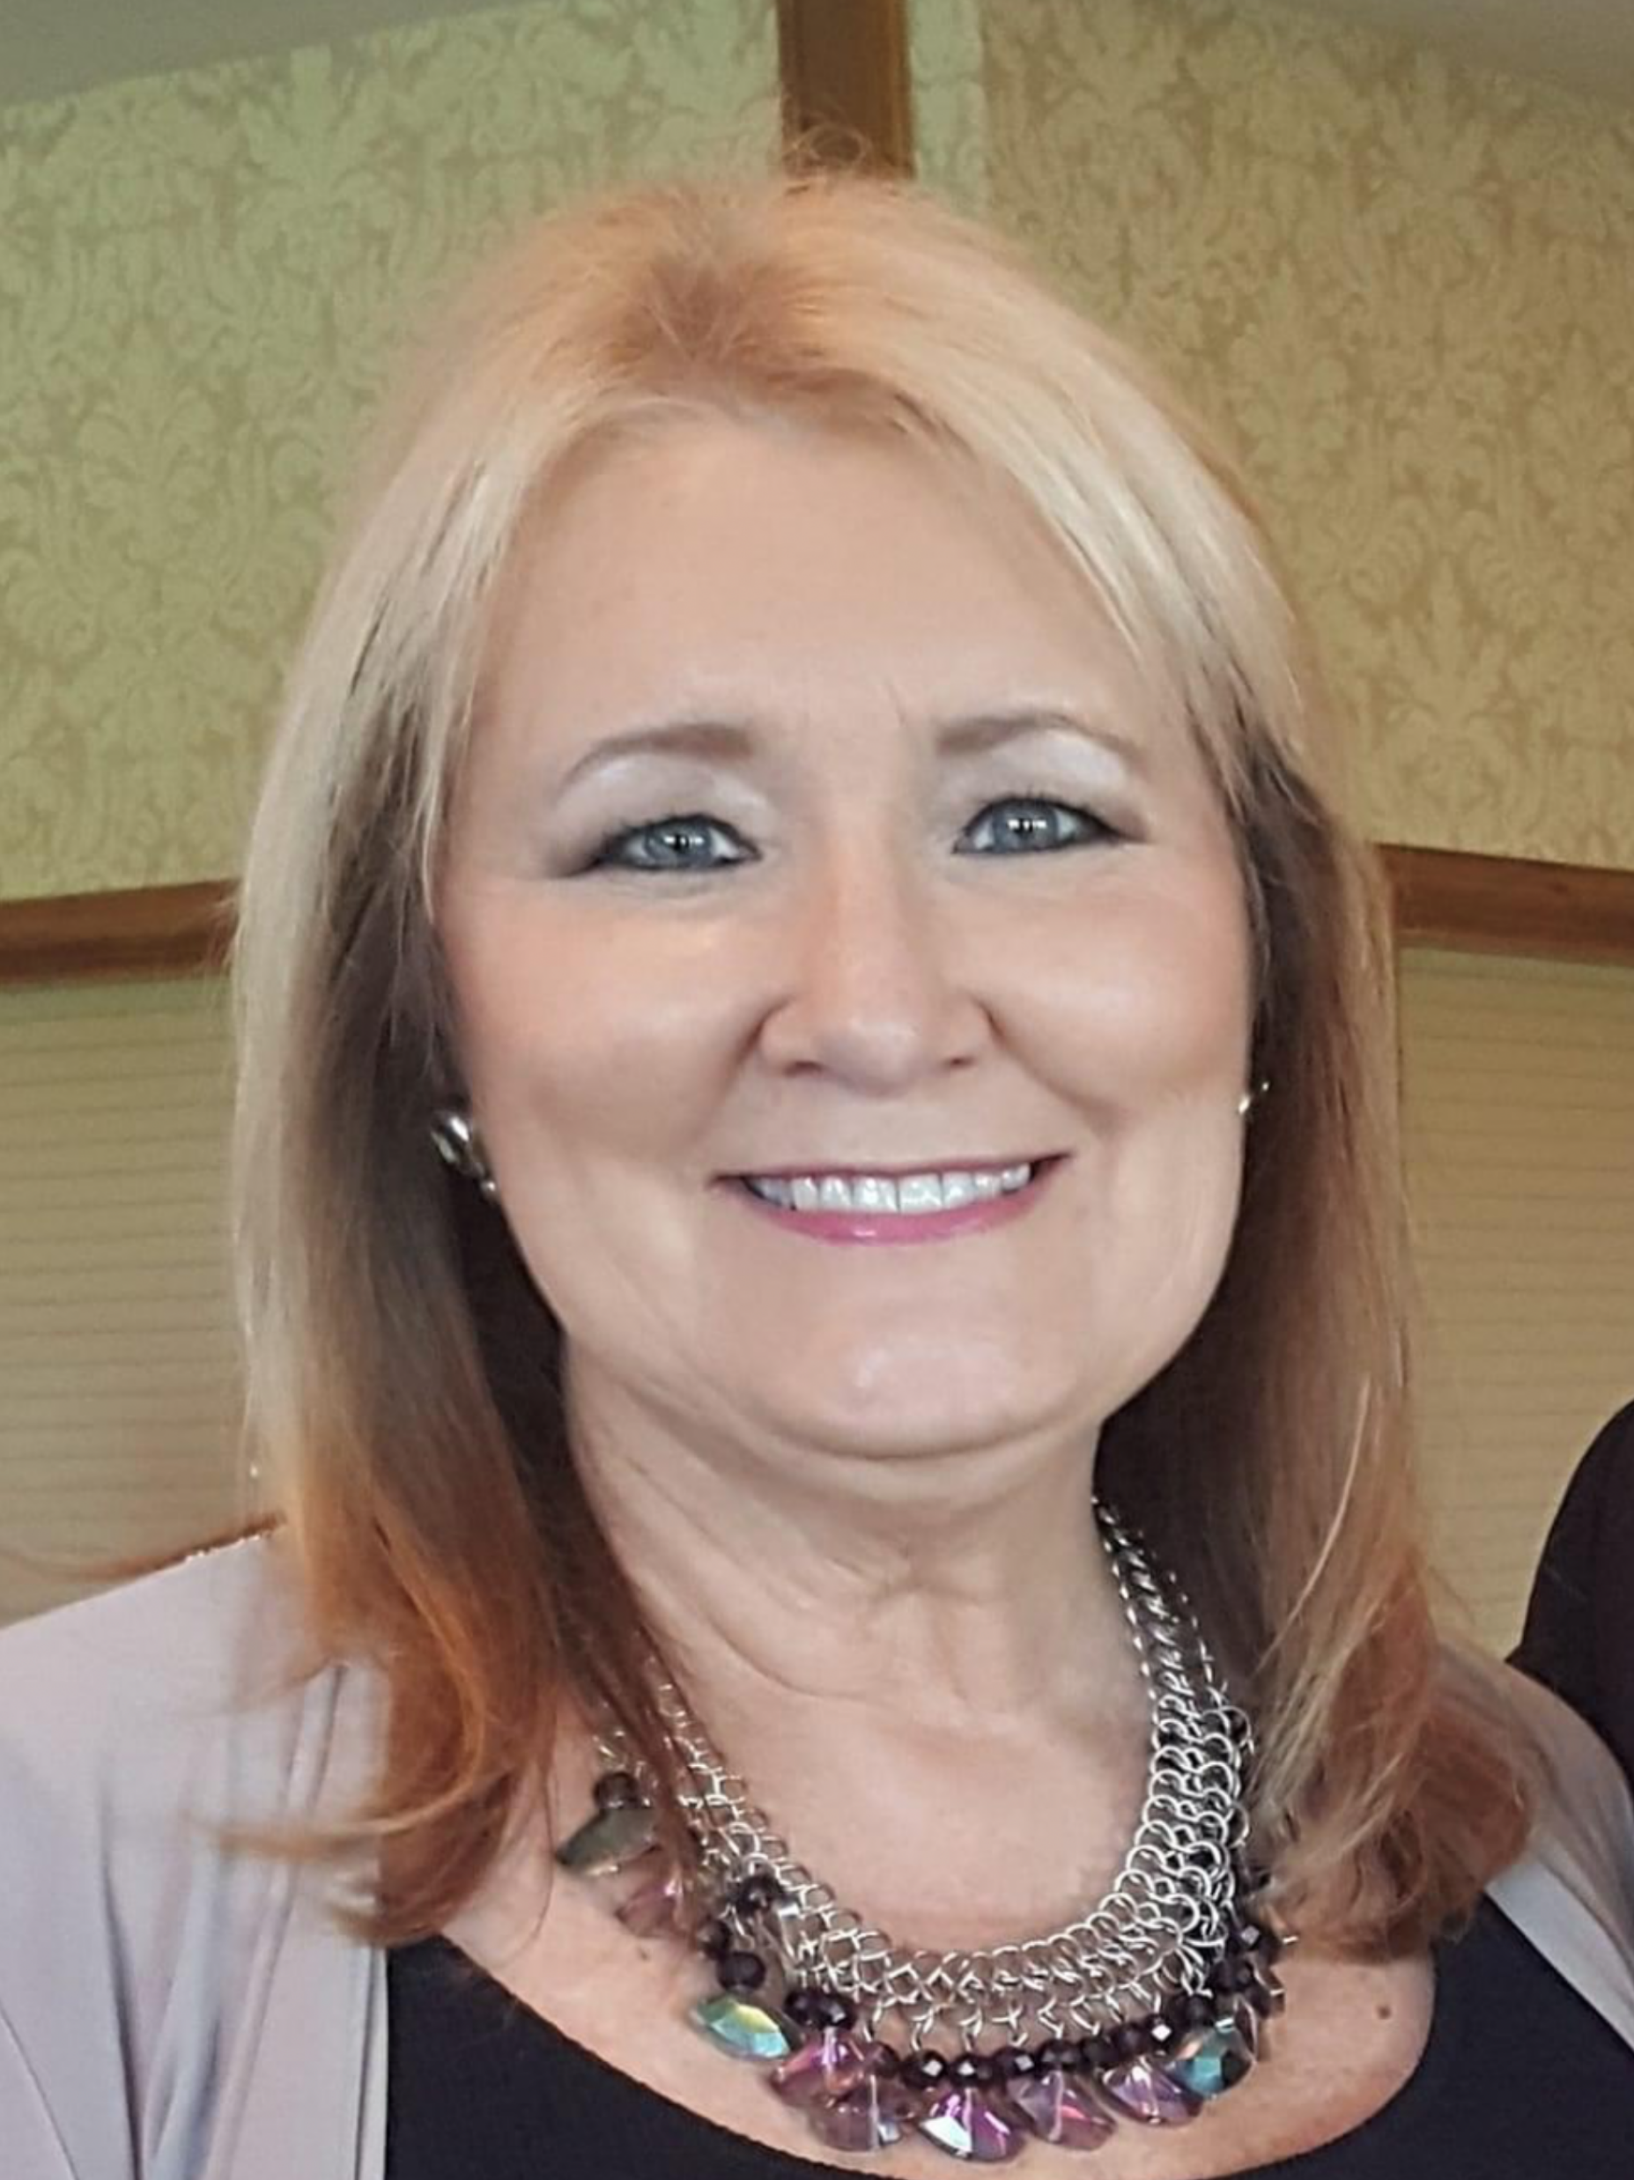
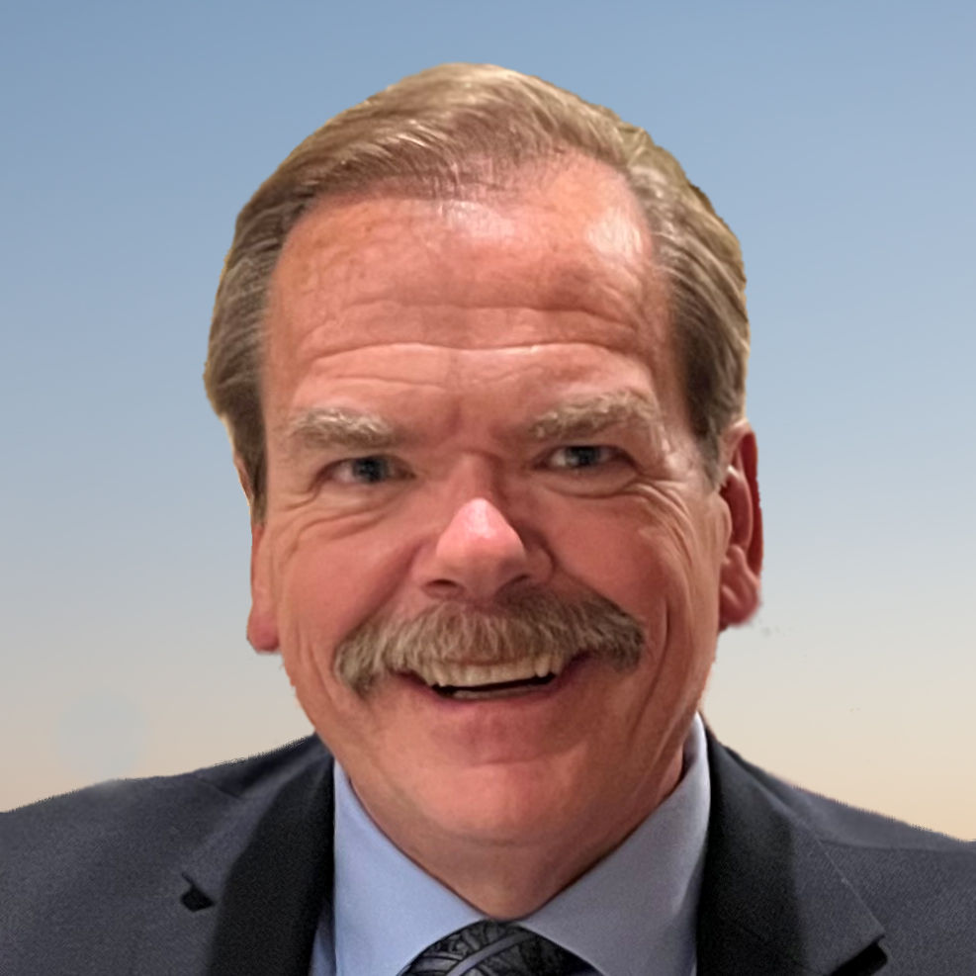
Beginning Genealogy 7 June 2022
Our Board
  President Elect: Sue Weber, Annapolis, Maryland, USA
  Secretary: Susan Beety, Menomonie, Wisconsin, USA
  Treasurer: Michael Fekete, Menomonie Wisconsin, USA
  Director A: Lawrence Tristram, Bordon, Hampshire, UK
  Director B: Bruce Richardson, Mississauga North, Ontario, Canada
  Director C: Luanne Newman, League City, Texas, USA
Today’s Presenter: Bill Harvey
  Attorney and genealogist
  Researching Genealogy since 1976
  Practicing Law since 1988
  Rotarian since 1997
  President of FORG 2020-2022
  Past President: Rotary Club of Omaha NE USA
  Current District Foundation Chair, D5650
  Incoming Endowment/Major Gift Advisor, Rotary Region 36
  paulharrisrocks@gmail.com
© 2022 Fellowship of Rotarian Genealogists. All Rights Reserved.

Slide 4
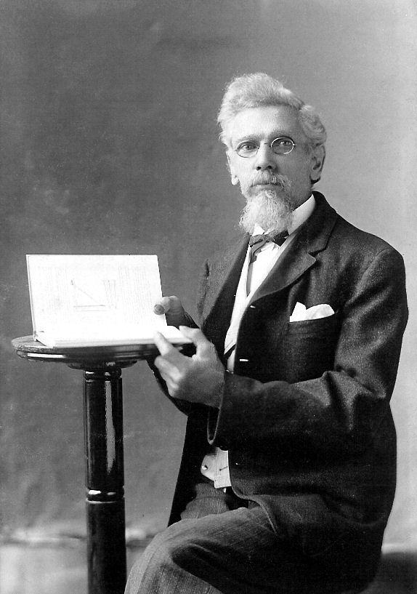
1. Decide on a Genealogy Goal
Beginning Genealogy 7 June 2022
Learn Where You Came From
Find Out How Your Family Fits Into History
Write a Family History Book
Solve a Family Mystery
Verify (or Disprove) a Family Legend
Find Your Birth Family
. . . ?
What is Your
Genealogy Goal?
© 2022 Fellowship of Rotarian Genealogists. All Rights Reserved.

Slide 5
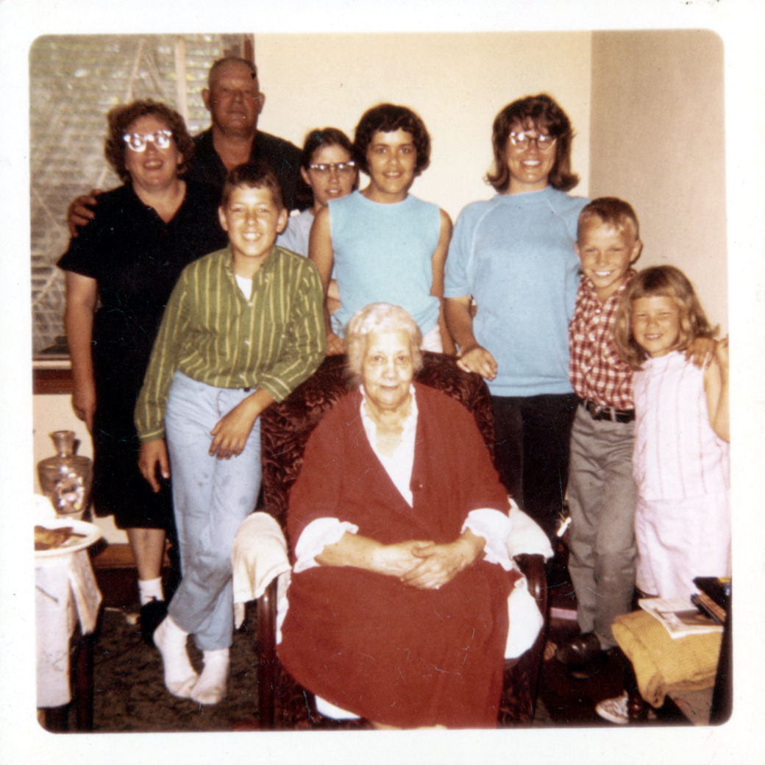
2. Start with
What You Know
Beginning Genealogy 7 June 2022
Download a Pedigree Chart from our Virtual Booth or Website.
Start with Yourself, your Descendants, Parents, Siblings and begin to fill in Names, Dates, Places and Information you know.
Watch the Acorn Video at our Virtual Booth, a great summary of the process (thanks to our Fellowship co-founder, Lawrence “Tris” Tristram who created the Acorn Video).
Record the stories you have heard about your family, and where you heard them.
© 2022 Fellowship of Rotarian Genealogists. All Rights Reserved.

Slide 6
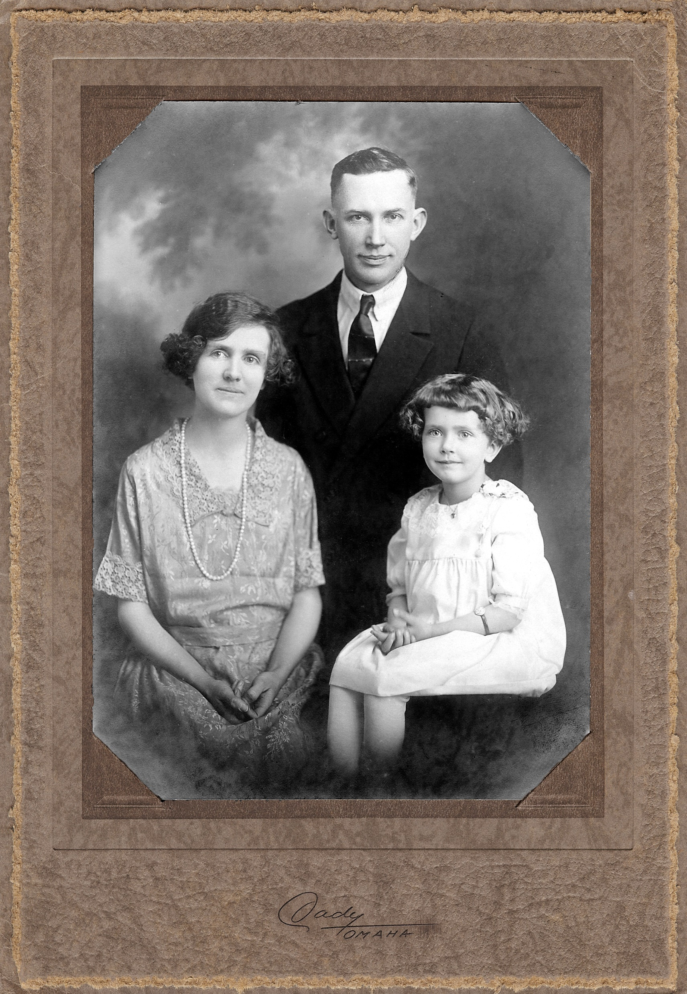
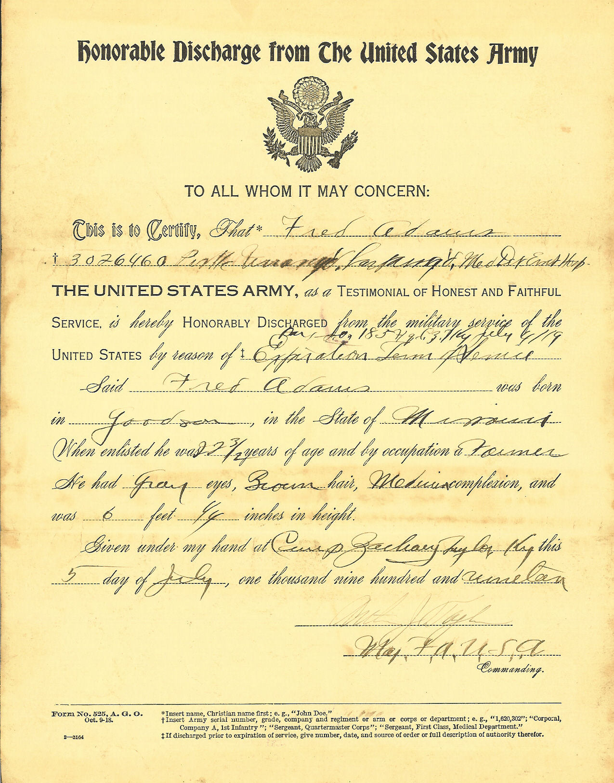
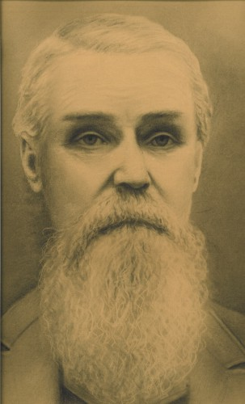
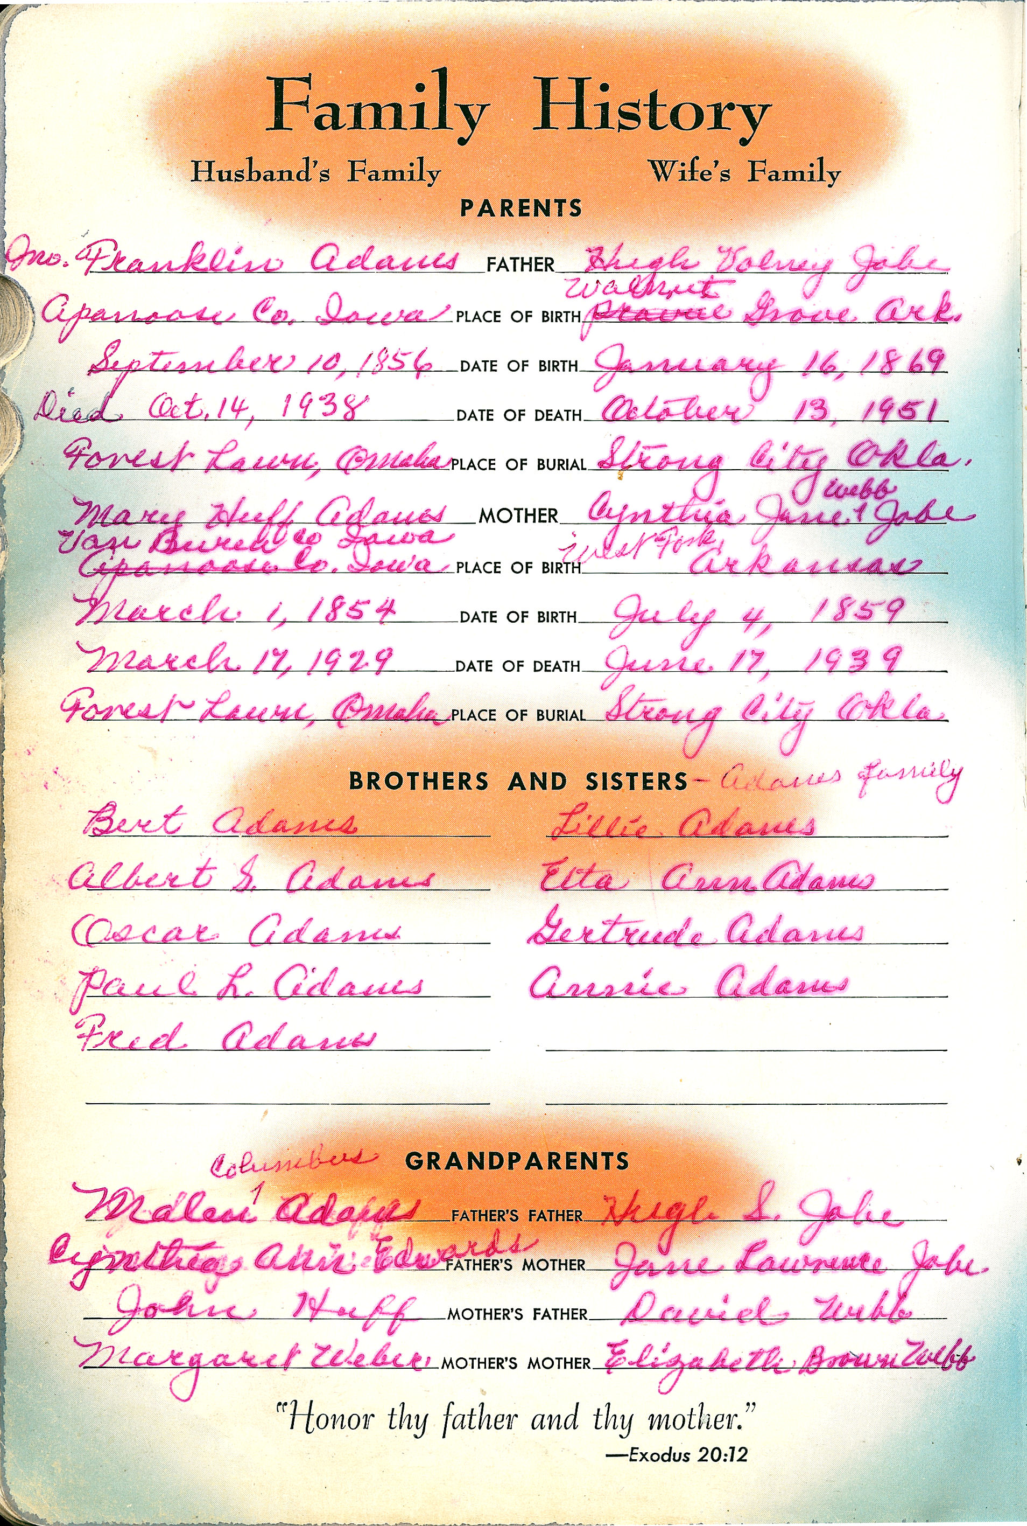
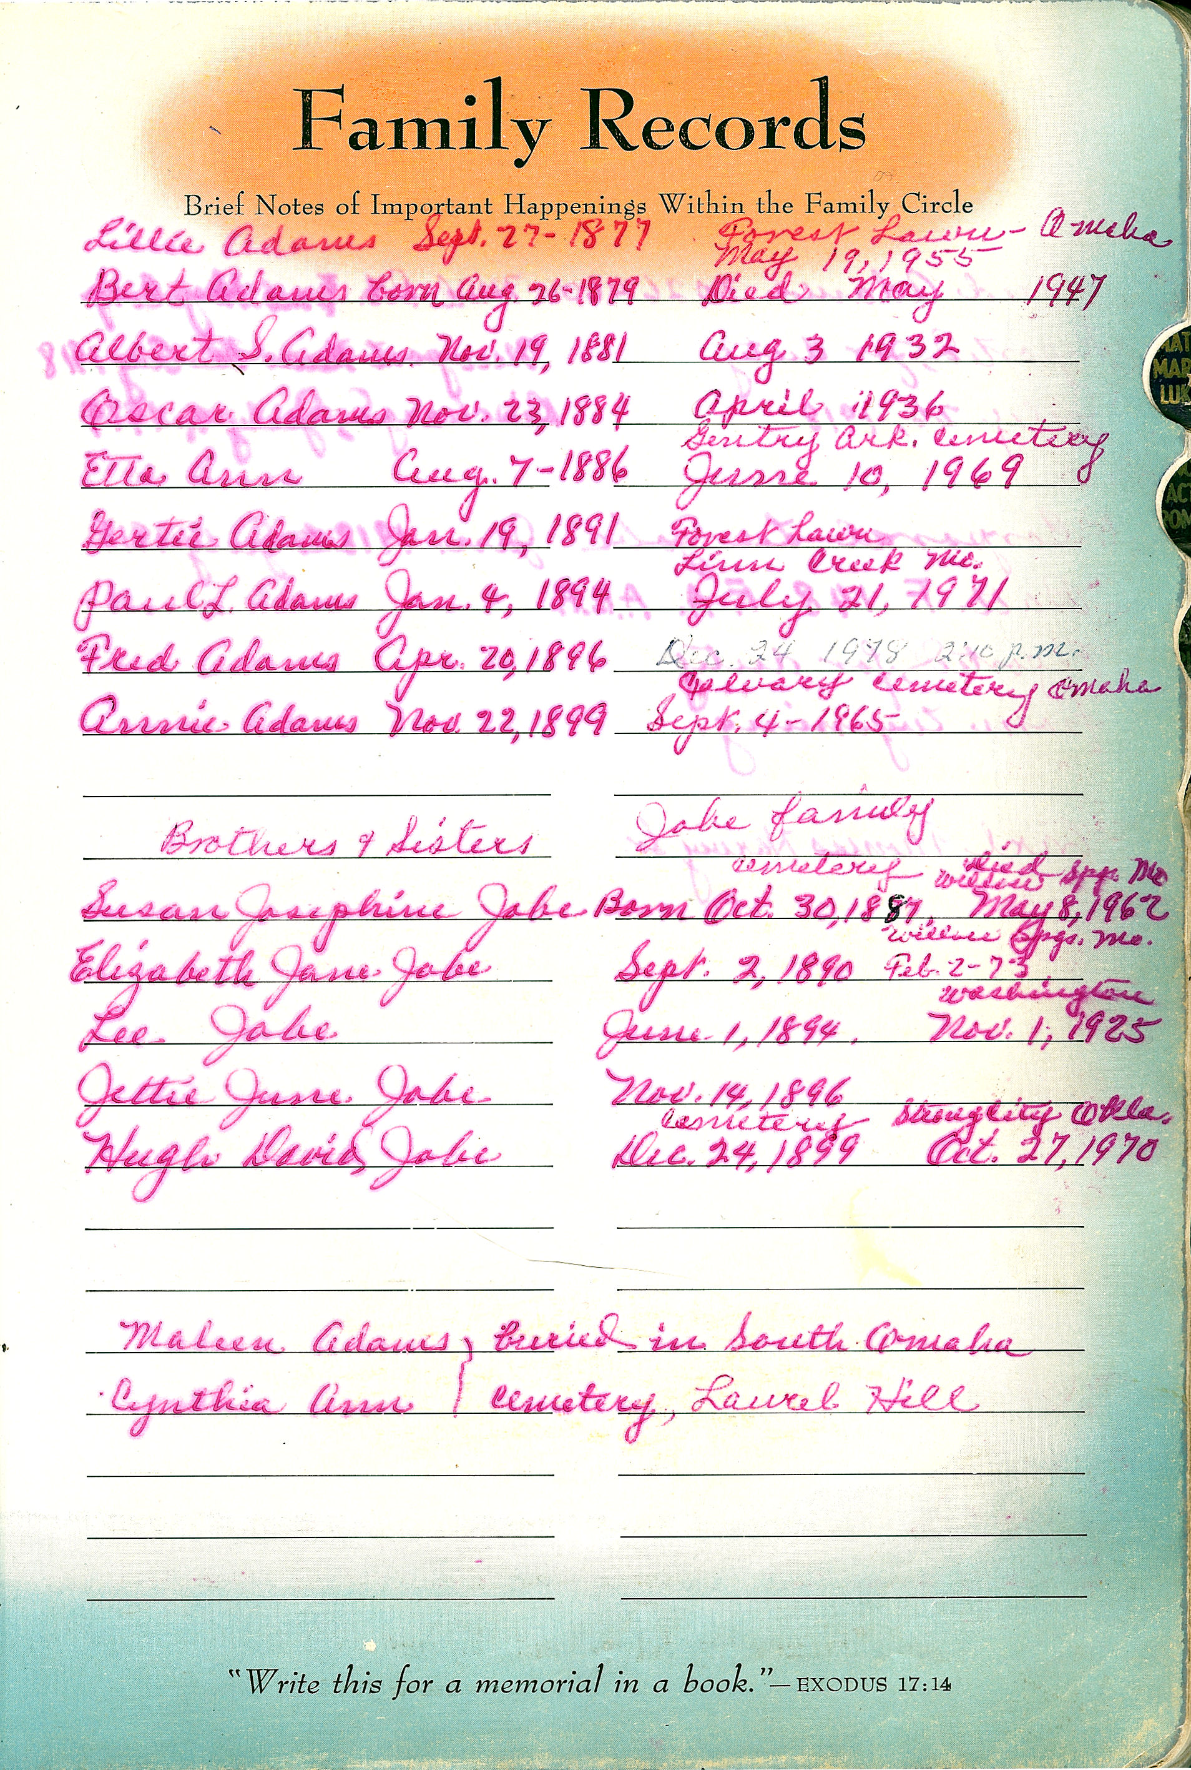
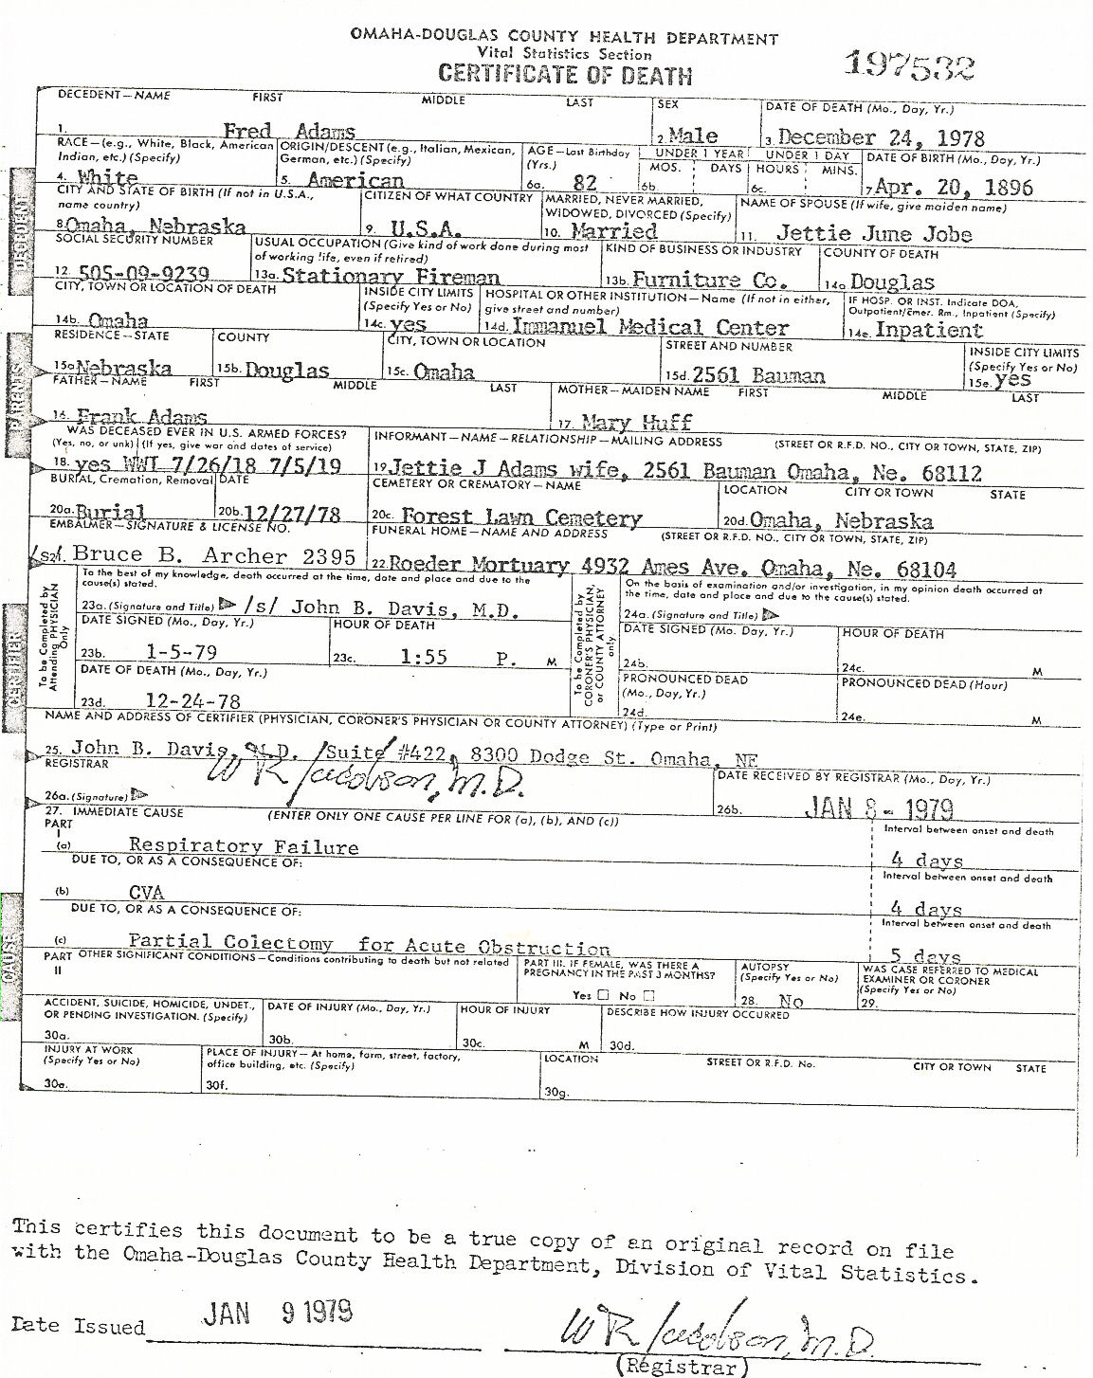
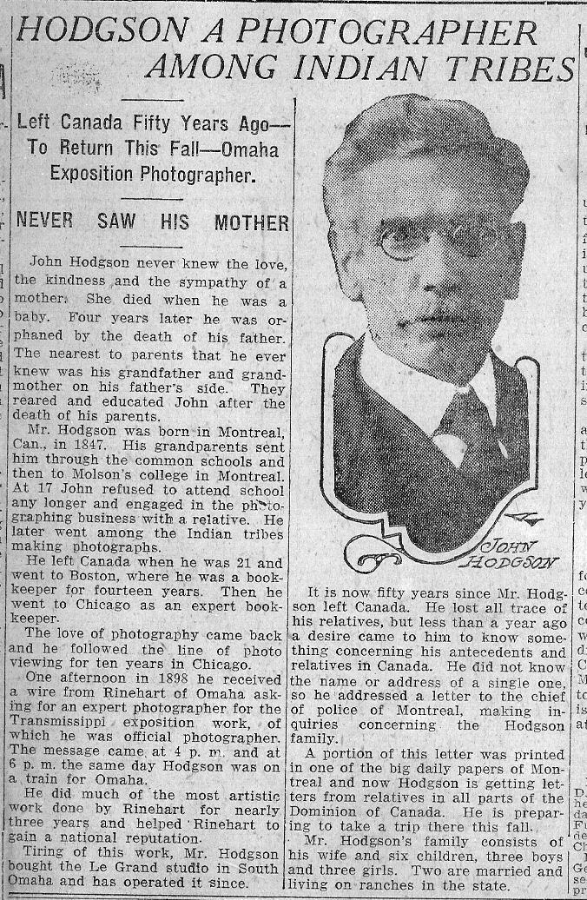
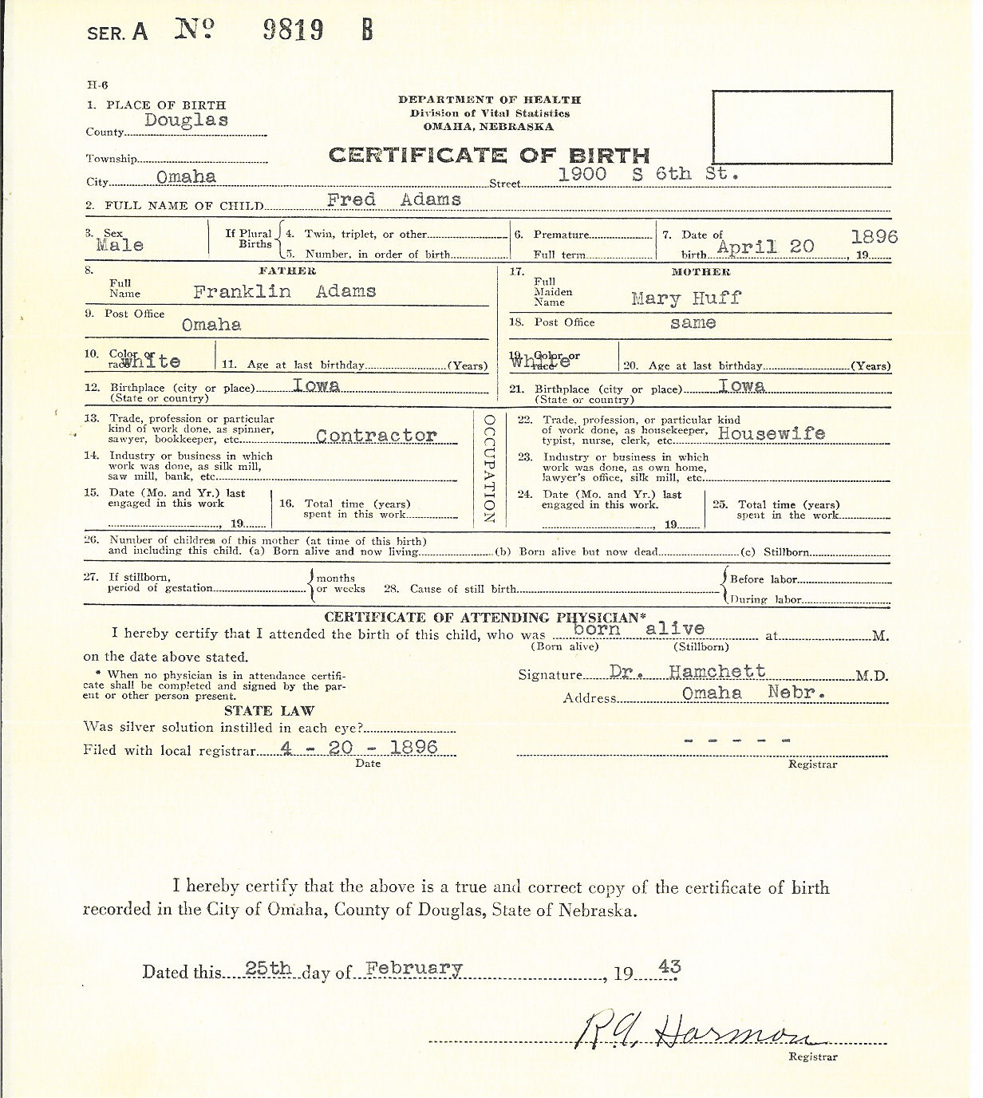
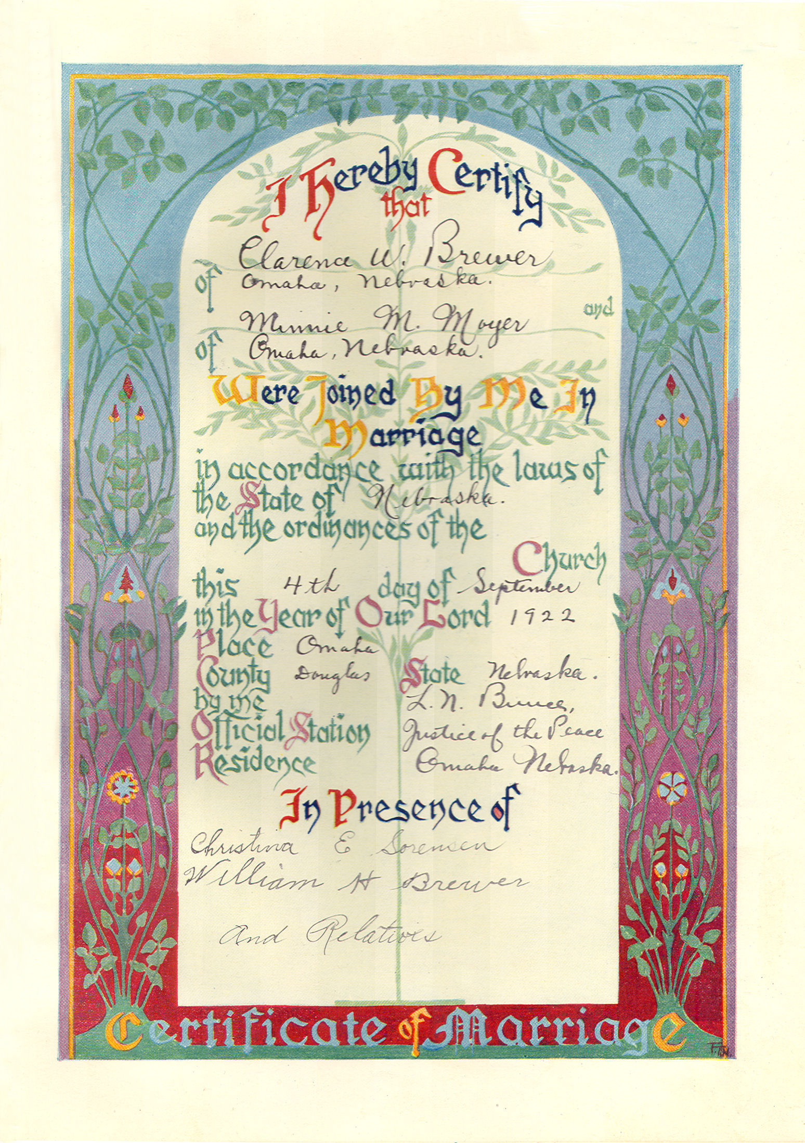
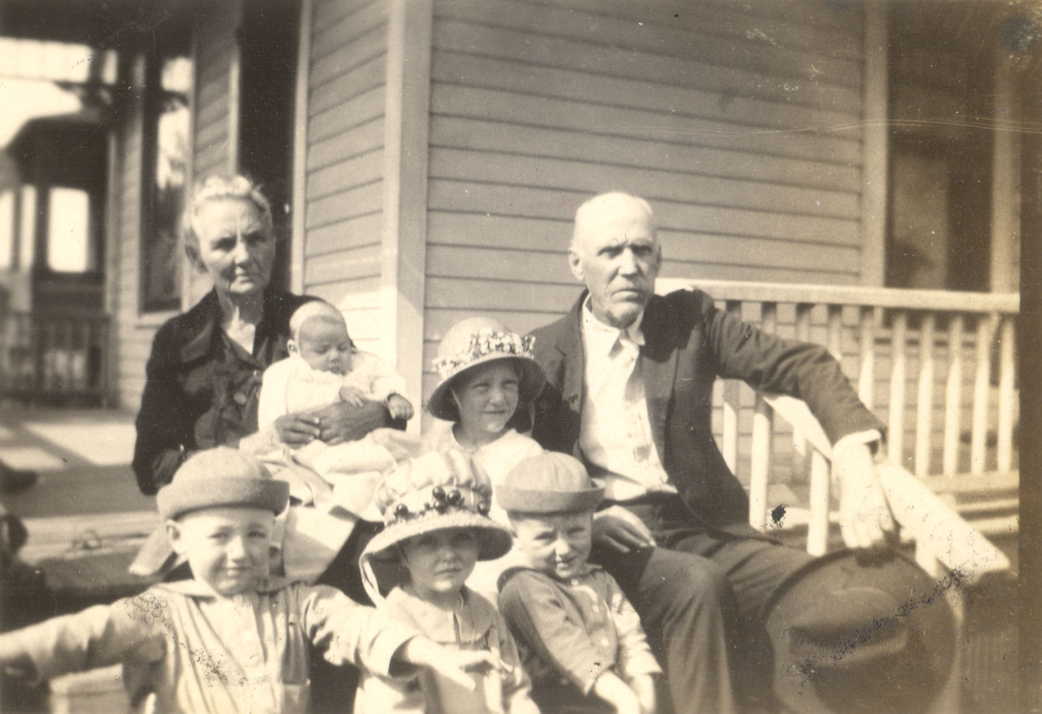
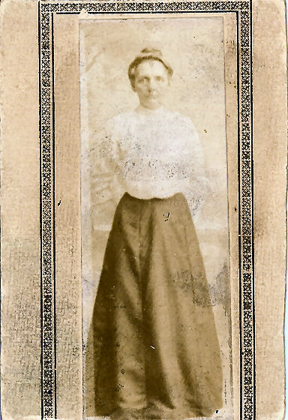
3. Gather the
Sources You have
Beginning Genealogy 7 June 2022
Birth, Death and Marriage Certificates
Obituaries
Funeral Programs
Family Bibles or other books where family information is written down, other religious documents
Military Records
Deeds, wills, and other legal documents
News clippings, stories and other information
Family Photos
Examine everything carefully!
Clues are hiding everywhere.
© 2022 Fellowship of Rotarian Genealogists. All Rights Reserved.

Slide 7
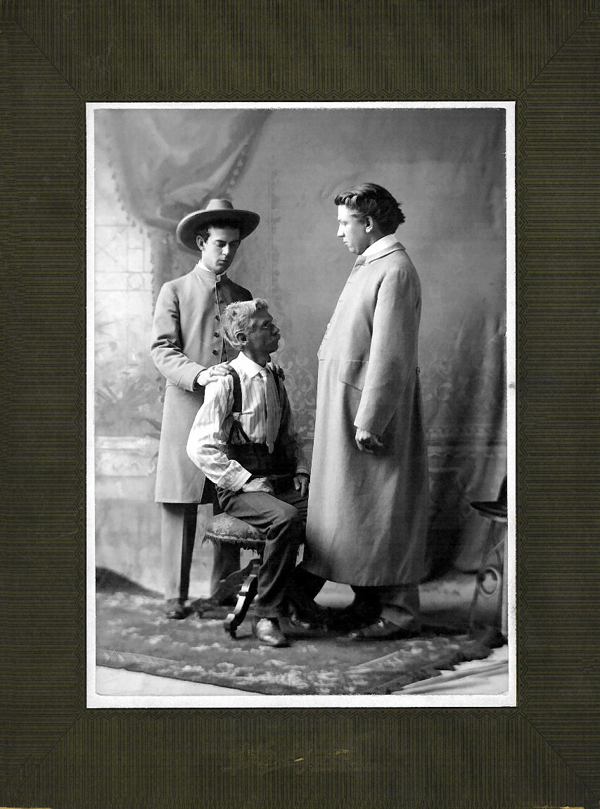
4. Talk to
Your Relatives
Beginning Genealogy 7 June 2022
Consider starting with your oldest relatives first.
Ask them what they remember about the family, building on what you already have.
Get their stories and recollections if possible.
Zoom can be a great option if your relative is familiar with it.
Record the conversation if you can, with consent of course.
Ask if they have documents or pictures.
Make copies or take photos with your phone (make sure they are clear and readable before you leave).
The more relatives you talk to,
the better.
© 2022 Fellowship of Rotarian Genealogists. All Rights Reserved.

Slide 8
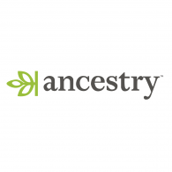



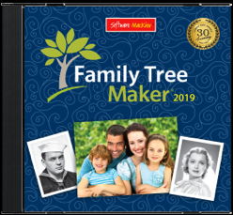
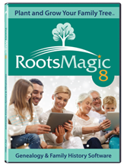
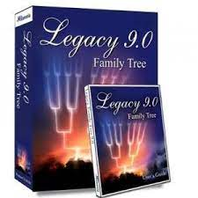
5. Time to Plant
Your Tree
Beginning Genealogy 7 June 2022
Websites
Considerations
Website or Desktop
Price (approximate full annual prices shown)
Length of Subscription
Research Integration (Hinting)
DNA Integration
All These Platforms Have Pros and Cons – Find What Works for You.
$299/yr
$299/yr
Free
$179/yr
Desktop Software
© 2022 Fellowship of Rotarian Genealogists. All Rights Reserved.
$80
$40
$35

Slide 9
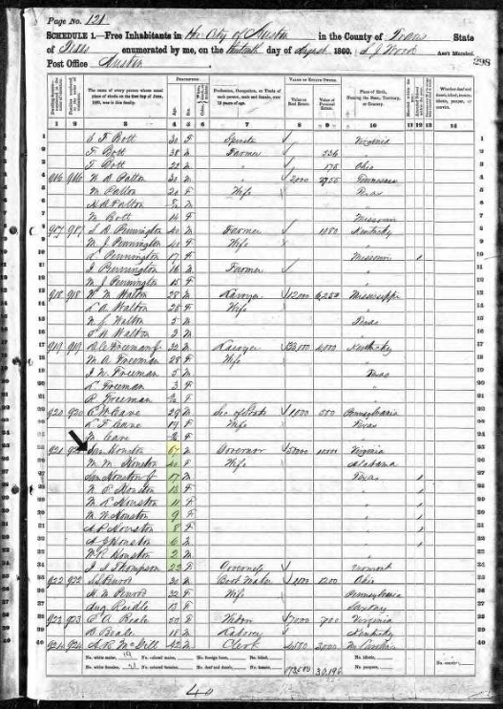
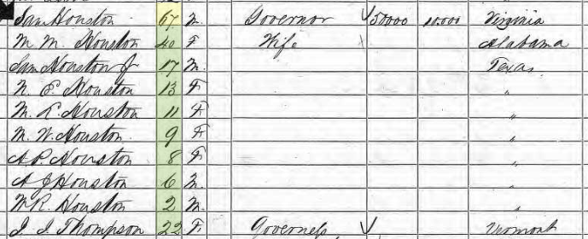
6. Start Your
Research
Beginning Genealogy 7 June 2022
US Federal Census Records:
  Every 10 years
  1790-1950 (1890 lost)
  All household members named from 1850 onwards
  Each census year provides somewhat different information
  Available at all major sites
  1950 Census was released
  01 Apr 2022
Other countries also kept census records. For example, UK just released the 1921 Census.
Timeframe and coverage varies by country and locale.
There are thousands and thousands of datasets beyond the census, and each site offers a different collection of records.
At some point you will need to get out and visit an archive
1860 United States Federal Census record for Sam Houston, Austin TX
© 2022 Fellowship of Rotarian Genealogists. All Rights Reserved.

Slide 10





7. Searchable
Newspapers
Beginning Genealogy 7 June 2022
Newspapers can add fascinating context to your family story.
Millions of pages are online already, with thousands more being added every day.
Some sites are free, but others are by subscription (prices shown are approximate).
These are a few of the larger sites, but there are hundreds of sites that offer searchable newspapers.
Free
$99/yr
$140/yr
$80/yr
© 2022 Fellowship of Rotarian Genealogists. All Rights Reserved.
Free
07 April 1930

Slide 11





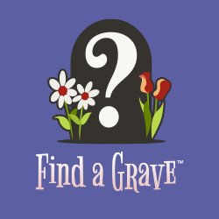



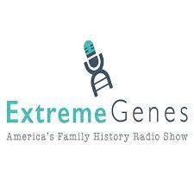
8. Free
Resources
Beginning Genealogy 7 June 2022
Research Wiki
Catalog Search
Books
Some of the Best Genealogy Resources on the Internet are Free.
These are just a few of the Free Resources available.
No single genealogy site has everything, and many of these sites have resources found nowhere else on the web.
There are Thousands of Free Resources Available – see Cyndi’s List to get started.
User Groups
Family Groups
DNA Groups
Your Local Library
© 2022 Fellowship of Rotarian Genealogists. All Rights Reserved.
And Other Blogs

Slide 12
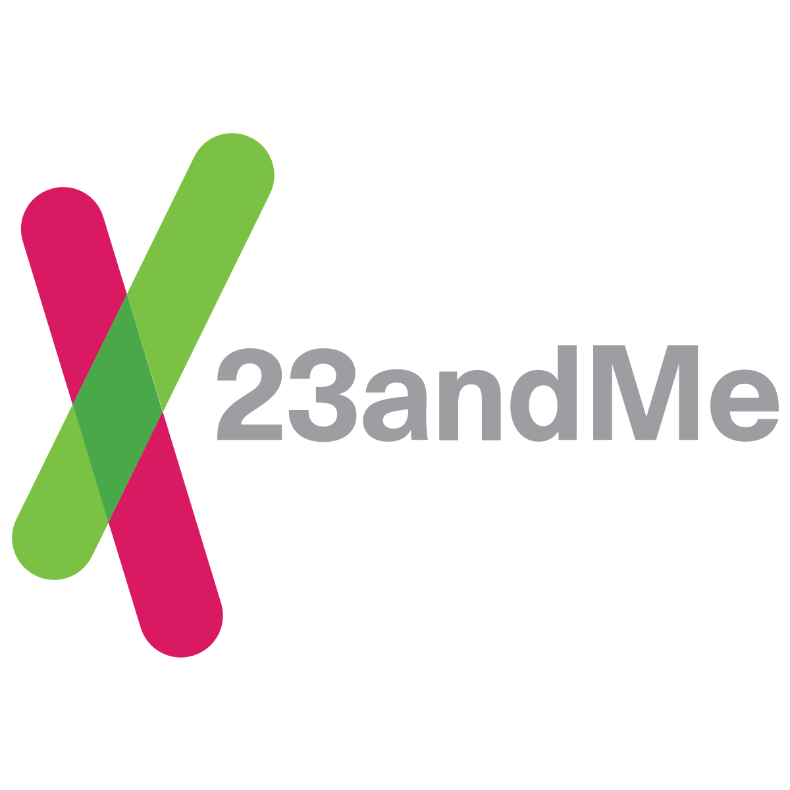
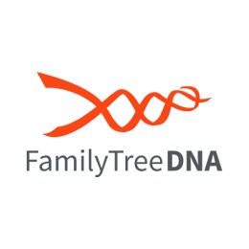
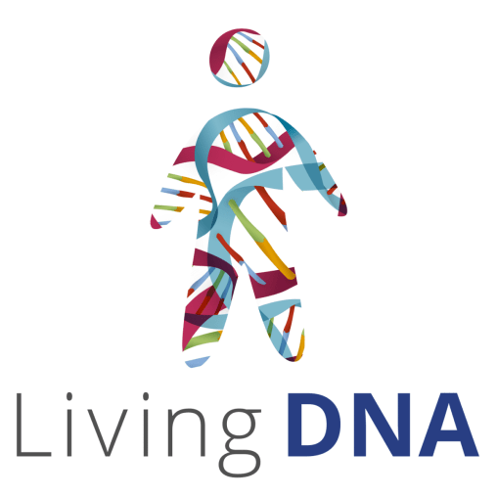
9. DNA
Beginning Genealogy 7 June 2022
DNA is changing how people do genealogy.
Ethnicity Results (pie charts) that are the most familiar aspect of DNA testing, have little to no genealogical value.
The real value of DNA testing to genealogical research is matching with other test takers.
Watch for sales during holidays (US Father’s Day sales going on right now).
A great place to learn more about DNA: International Society of Genetic Genealogy (ISOGG).
$99/kit
$79/kit
$99/kit
$79/kit
© 2022 Fellowship of Rotarian Genealogists. All Rights Reserved.
$99/kit

Slide 13
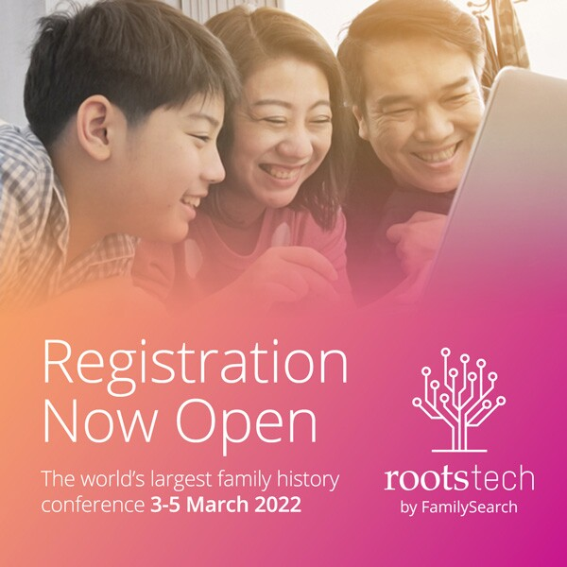

10. Educate
Yourself
Beginning Genealogy 7 June 2022
There are many opportunities to learn more about all aspects of genealogy.
RootsTech Connect and various YouTube Channels provide access to video instruction.
Genealogy Conferences, live and virtual, are a great way to learn more, and collaborate with other genealogists.
Subscribe to Genealogy Blogs and Newsletters to get regular updates (Cyndi’s List – Blogs for Genealogy).
A classic newsletter is Eastman’s Online Genealogy Newsletter – free and paid content.
When you get further along, you might want to attend a genealogy institute where you can get in depth on a specific subject for a week or more.
Ancestry Channel
23andMe Channel
FamilySearch Channel
FindMyPast Channel
Who Do You Think You Are
And so many more
Find out about upcoming live and virtual genealogy conferences
ConferenceKeeper.org – the most complete collection of genealogy events online
National Genealogical Society – Genealogy Events Calendar
Cyndi’s List – Events Calendars
© 2022 Fellowship of Rotarian Genealogists. All Rights Reserved.

Slide 14
11. Some General
Tips
Beginning Genealogy 7 June 2022
Be consistent when recording information.
Record all dates like this: 7 Jun 2022. Record places starting with the smallest subdivision and working to the largest: Houston, Harris, Texas, USA. Be consistent throughout your genealogical work and you’ll be much happier when you see your results.
Be Skeptical.
Take nothing for granted. You will find many inconsistencies in ages, dates and places as you move along. Think about what makes sense in context.
Seek Out Genealogical Societies.
Consider joining the local genealogical society where you live (they need your support and often have opportunities for service).
  Texas State Genealogical Society
  List of Societies Related to Harris County
Also seek out genealogical societies in the places you are researching. For example, the Quebec Genealogical eSociety has been a great help in researching my Quebec ancestors.
Cite and Record your Sources.
When you record information, be sure to note where it came from, and leave yourself and future researchers enough breadcrumbs to find that source in the future. You’ll thank yourself later if you do this consistently.
© 2022 Fellowship of Rotarian Genealogists. All Rights Reserved.

Slide 15
12. Remember the
4-Way Test
Beginning Genealogy 7 June 2022
These are some thoughts I have about the 4-Way Test in relation to genealogy. Each Rotarian will have to consider how these questions play out in their own research.
Is it the Truth?
In genealogy, truth is paramount. Remember to check your work, cite your sources, and look to the original records whenever possible.
Is it Fair to All Concerned?
Think about your ancestors in the context of their time, not ours. And consider how their actions may have affected others, both in their time and down to the present day.
Will it Build Good Will and Better Friendships?
Be generous with your genealogical findings. Share your genealogy freely and use the stories you find to build bridges with relatives and others. Seek out opportunities for genealogical service.
Will it be beneficial to all concerned?
When you come across something in your genealogical research that is painful, thoughtfully consider how you will treat that information and share it with others.
© 2022 Fellowship of Rotarian Genealogists. All Rights Reserved.

Slide 16
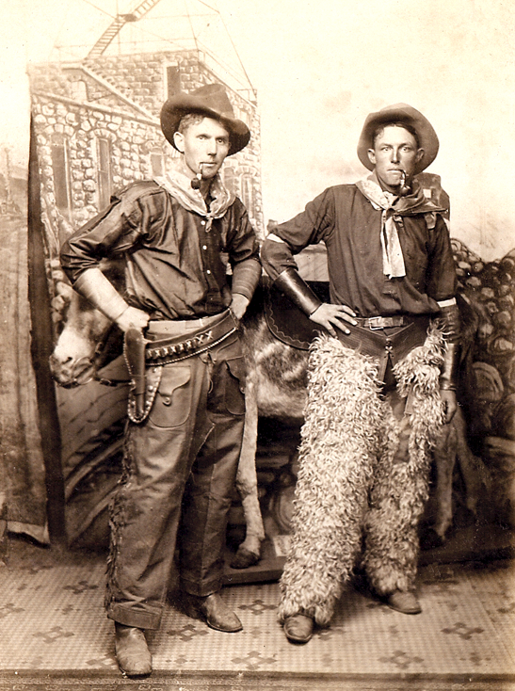
Thank You, and Happy Hunting!
(P. S. – Remember to Have Fun!)
Beginning Genealogy 7 June 2022
© 2022 Fellowship of Rotarian Genealogists. All Rights Reserved.

